Slide 1
MYOCARDIAL VIABILITY
JOURNAL REVIEW
ANKUR KAMRA

Slide 2
Myocardial viability is defined as myocardium with potentially reversible contractile dysfunction in patients with CAD.
Concept of myocardial hibernation was introduced by Rahimtoola to describe a condition of chronic sustained abnormal contraction attributable to chronic under perfusion in patients who have CAD and in whom revascularization causes recovery of LV function
Myocardial stunning defined as reversible myocardial contractile dysfunction in presence of normal resting myocardial blood flow
Vanoverschelde et al. suggested that repeated ischemic attacks may induce chronic dysfunction in presence of normal or mildly reduced resting perfusion this condition was referred to as repetitive stunning.
It appears that there is temporal progression from stunning, characterized by normal flow (with reduced flow reserve) to hibernation with reduced resting flow.

Slide 3
Introduction
Endpoints used in viability studies
  Improvement in regional LV function (segments)
  Improvement in global LV function (LVEF)
  Improvement in symptoms (NYHA functional class)
  Improvement in exercise capacity (metabolic equivalents)
  Reverse LV remodeling (LV volumes)
  Prevention of sudden death (ventricular arrhythmias)
  Long-term prognosis (survival)

Slide 4
Viability assessment by different investigations

Slide 5
METHODS OF VIABILTY ASSESMENT
Membrane integrity
uptake of Thallium and Rubidium
Metabolic activity
Fatty acids
PET, uptake of F-fluorodeoxyglucose (FDG) is a marker of glucose metabolism
Blood Flow
N13 H3, Tc99m-Sestamibi, Tc99m-tetrofosmin
Contractile reserve
Low Dose Dobutamine RWM analysis
Morphology
MR hyper enhancement

Slide 6
Viability assessment
DSE
Low dose- High dose dobutamine infusion
Viability assessment
Biphasic response- viability with superimposed ischemia
Worsening-severe ischemia with critical stenosis
No change- transmural scar
Continued improvement- no relation

Slide 7
FOUR DIFFERENT RESPONSE AND THERE PPV
Biphasic response with improvement at low dose and worsening at high doses seen in 28% of segments, sustained improvement seen in 18% of segments, sustained worsening seen in 15% of segments and no change in function seen 39% of segments
Biphasic response had PPV for functional recovery of 72%, response of worsening throughout had PPV 35% and segments that showed no change had a PPV of only 13%.
However low PPV of 15% noted for continued improvement, since most of these segments were hypokinetic at baseline and never exhibited signs of ischemia at peak stress, it was postulated that resting ischemia was not the mechanism for the underlying wall motion abnormality
Afridi et al Circuition I995;9I:663470

Slide 8
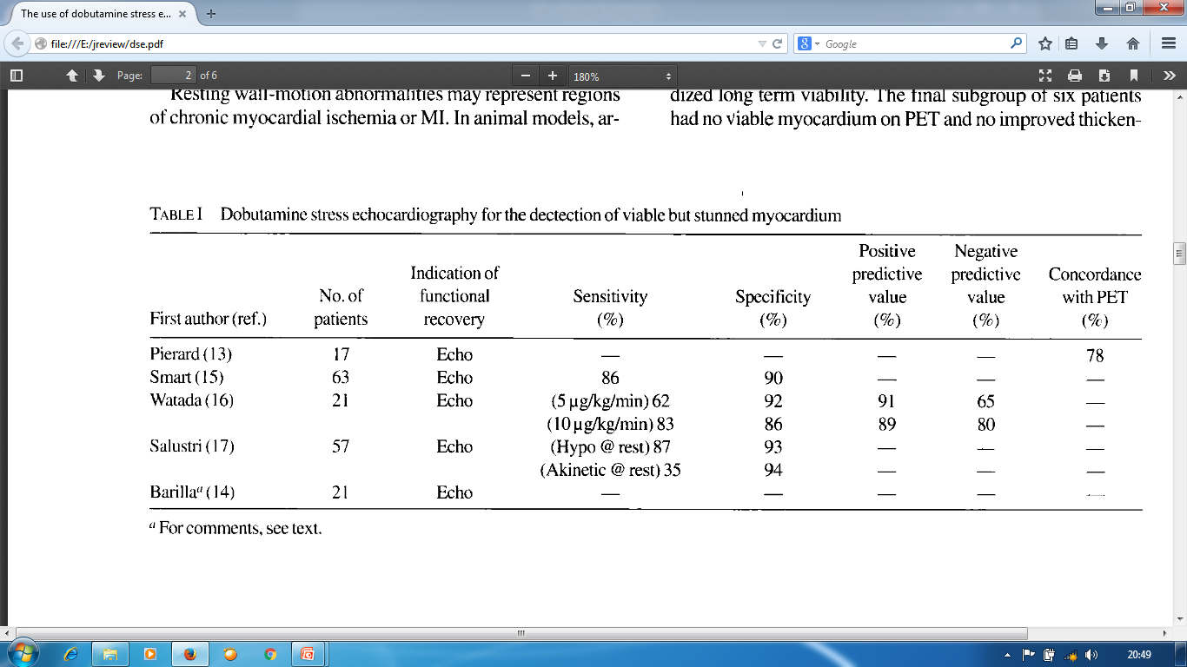
DSE for dectection of viable but stunned myocardium

Slide 9
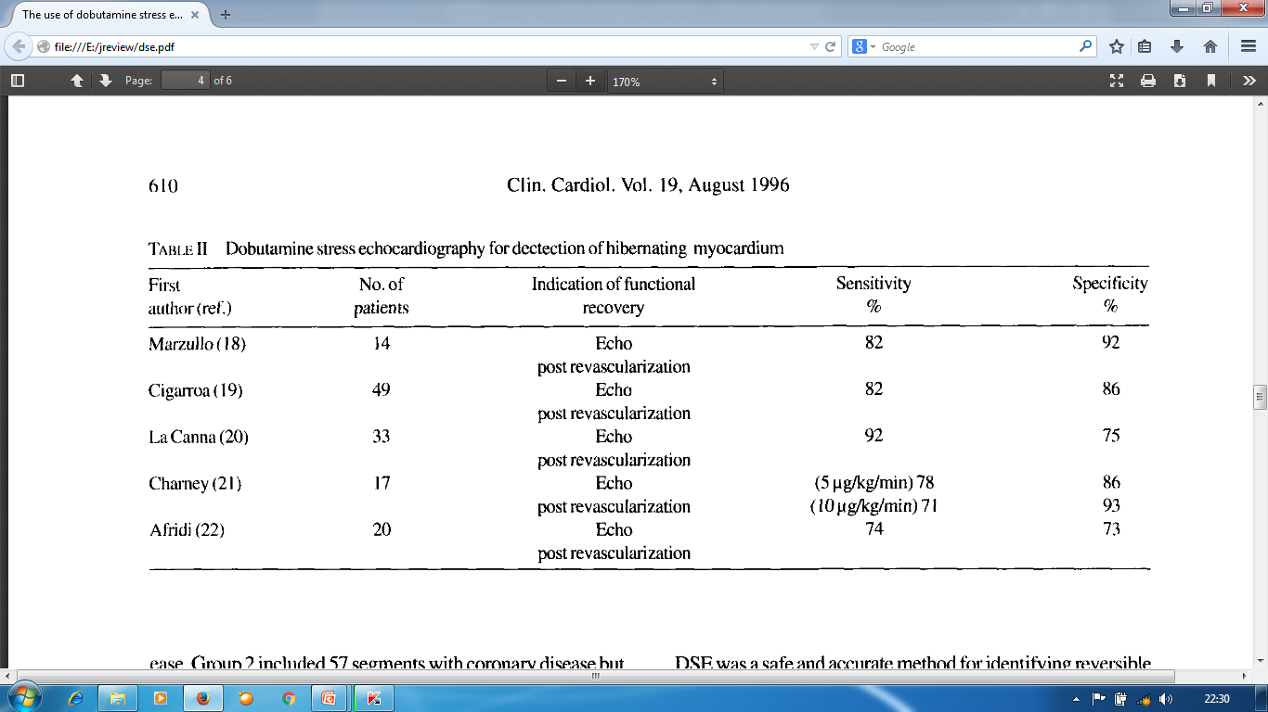
DSE for dectection of hibernating myocardium

Slide 10
Viability assessment
Ability to predict improvement in LVEF
 | % sensitivity | % specificity | % NPV | %PPV
32 studies [N= 1090] | 81 | 80 | 85 | 77
J Nucl Med 2007; 48:1135–1146
Ability to predict improvement in LVEF | Viability present |  | Viability absent
 | % LVEF pre | % LVEF post | % LVEF pre | % LVEF post
8 studies [N=254] | 35 | 43 | 35 | 36
J Nucl Med 2007; 48:1135–1146

Slide 11
Viability assessment
Viability, Trt. type & Event Rates in Pts with LVD and c/c CAD
 | % event rates
 | Viability present |  | Viability absent
 | Revascularization | Medical trt. | Revascularization | Medical trt.
6 studies (N= 686) | 6 | 22 | 16 | 28
J Nucl Med 2007; 48:1135–1146

Slide 12
Limitations
  Poor window in 30%
  Lower sensitivity
  Viable regions with absent flow reserve will not show thickening
  Reliance on visual assessment

Slide 13
TDI- strain rate imaging
  Augmentation of strain and strain rate with dobutamine is a marker of myocardial viability
  PET detected viable segments compared with strain rate imaging during low-dose dobutamine stress test [N=37]. An increase in the longitudinal strain rate of more than -0.23 S⁻¹ identified viable tissue [83% sens., 84% spec.]
J Am Coll Cardiol 2002;39:443-449

Slide 14
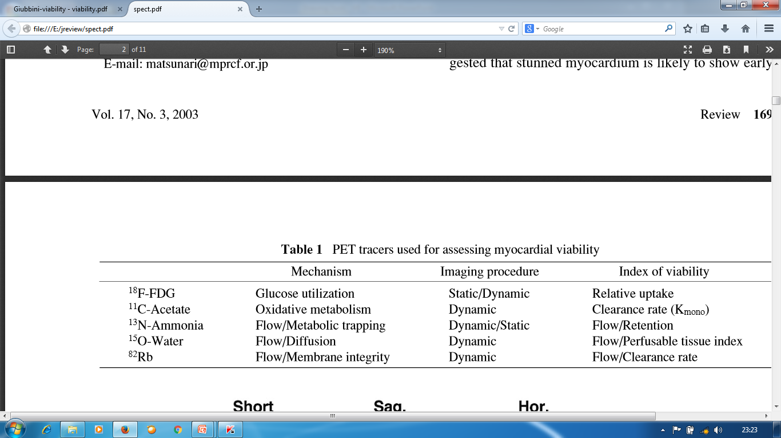
PET TRACERS

Slide 15
METABOLIC TRACERS
18 F-FDG uptake in hypoperfused and dysfunctional myocardium (flow- metabolism mismatch) is regarded as a metabolic marker of cell survival and viability, whereas concordant reduction in both blood flow and 18 F-FDG uptake is indicative of scar. Thus 18 F-FDG PET provides biological signal on cellular viability and is considered to be one of most accurate non invasive techniques to identify viable tissue
Haas F et al. J Am Coll Cardiol 1997; 30: 1693–1700
Tillish J et al. N Engl J Med 1986; 314: 884–888
18F-FDG may not be suitable for use in acute myocardial infarction due to inflammatory cell accumulation in necrotic tissue, which takes up 18F-FDG as does viable tissue so in these cases 11 C-Acetate can be used as tracer.

Slide 16
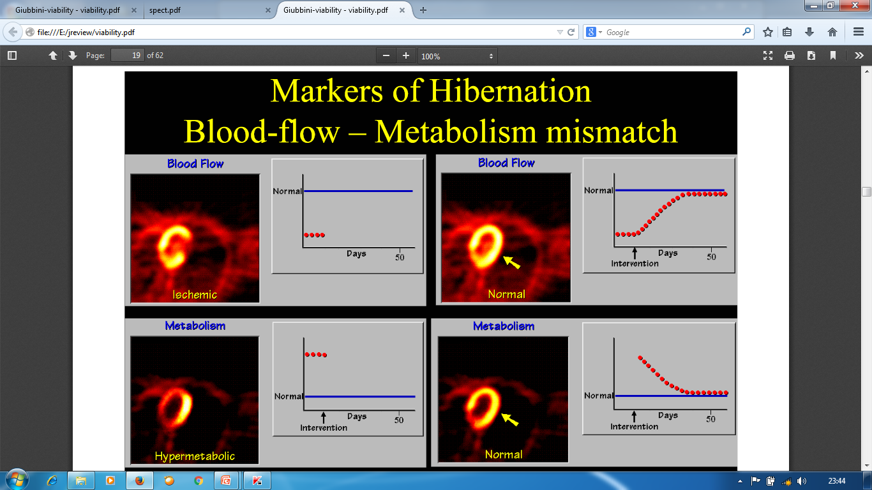

Slide 17
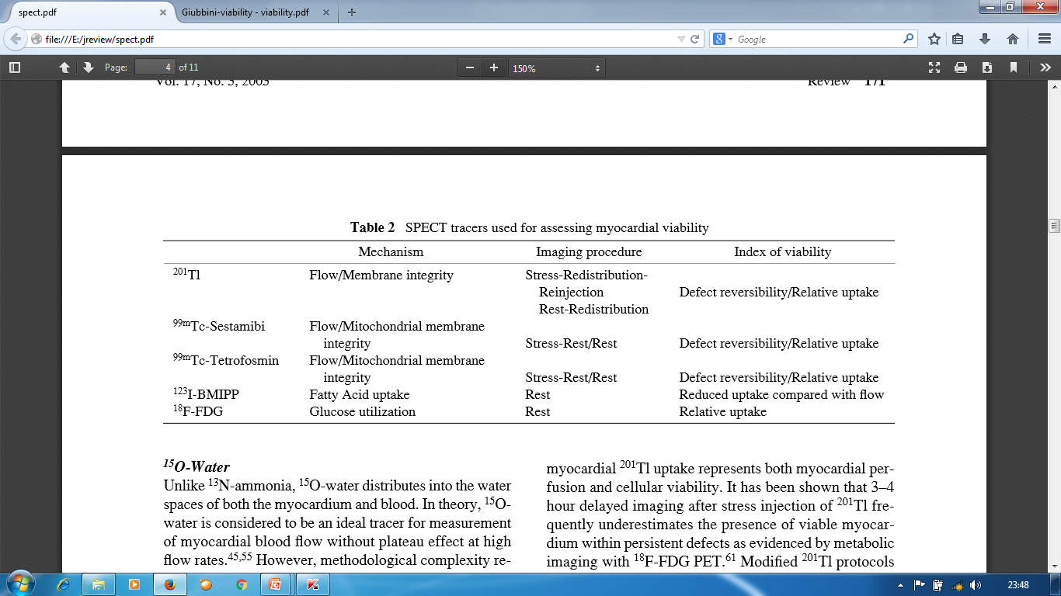
SPECT TRACER

Slide 18
201 Tl is taken up by myocardial cells by active transport and is dependent on myocardial blood flow. Therefore 201 Tl uptake represents both myocardial perfusion and cellular viability.
Various protocols used are
Stress -Normal perfusion
Delayed rest images or reinjection- fixed defect showing redistribution
Stress- defects with redistribution on delayed images
A study done by Kitsiou AN et al.(Circulation1998; 98: 501–508) and many other study shows that stress induced reversible defects which are more commonly seen on stress imaging than on rest imaging are highly predictive of functional recovery after revascularization. Thus use of stress imaging protocol is encouraged whenever possible
Notes:
Initial distribution of
201
Tl
is considered to reflect myocardial blood flow at rest, and
redistribution
201
Tl imaging to reflect myocardial viabil-
ity rather than mere perfusion

Slide 19
A defect that persists and appears again on 3–4hr images(i.e. fixed defect) may be due to : (1)markedly reduced regional perfusion (2)impaired cellular membrane integrity
(3)cell death (acute infarction)
(4)scartissue.
Thus fixed-defects on 3–4hr redistribution images may represent only severely hypoperfused—and not necessarily infarcted tissue

Slide 20
Technetium-99m labeled flow tracers such as 99mTc-sestamibi and 99m Tc-tetrofosmin are now widely available as alternatives to conventional 201 Tl. As compared With 201Tl, these 99mTc-labeled agents yield higher image quality.
123I-beta-methyl iodophenyl pentadecanoic acid (BMIPP) is a fatty acid analog that is not metabolized by beta-oxidation, because myocardial fatty acid uptake is easily depressed in ischemic but viable myocardium,BMIPP imaging in combination with flow tracer can also detect potentially reversible myocardium.

Slide 21
Dobutamine CMR
Contractile reserve can be assessed by CMR using low dose dobutamine stress testing. Similar to echo, CMR allows visualisation of cardiac motion but is characterised by superior endocardial border definition, facilitating more accurate wall motion and wall thickening assessment.
Majority of studies showed a relatively modest sensitivity but high specificity of dobutamine CMR for detection of viable myocardium, ranging from 50–90% and 73–94% respectively.
Baer FM et al Circulation1995;91:1006–15
Gunning MG et al Circulation1998;98:1869–74

Slide 22
Viability Assessment
DE CMR
Viability criteria
  Increase in End-diastolic wall thickening > 2 mm
For predicting functional recovery | % sensitivity | % specificity
9 studies [N= 252] | 73(50-89) | 83(70-95)
Heart 2005;91:1359–1365

Slide 23
Baer et al in a study, evaluated viability by MRI after myocardial infarction comparing to PET as the gold standard. Patients with myocardial infarction (infarct age 4 months) were studied with low-dose Dob-MRI examinations, with viability defined by an end-diastolic wall thickness of 5.5 mm and evidence of dobutamine-induced systolic wall thickening of 1 mm.
When both these parameters were used as criteria for viability, Dob-MRI demonstrated a sensitivity of 88% and specificity of 87%.
Circulation 1995;91:1006-1015.

Slide 24
ceCMR
Regions of myocardial infarction exhibit high signal intensity (contrast enhancement) on T1-weighted images after administration of contrast such as gadolinium based agents.
ceCMR is effective in identifying the presence, location and extent of acute and chronic myocardial infarction
Kim RJ et al. Circulation 1999;100 :1992–2002 Landmark study comparing contrast enhancement to histopathology and concluding that contrast enhancement occurs in the setting of irreversible myocardial injury only
Because of superior spatial resolution it can detect micro-infarcts, as well as sub endocardial infarcts which are missed by SPECT
Wagner A et al. Lancet 2003; 361:374–9. Landmark study concluding that ceCMR detects myocardial infarcts which are missed by SPECT imaging.

Slide 25
Likelihood of functional improvement inversely related to extent of hyperenhasment.
78% patients improve with no hyper enhancement while only 2% with >75% HEI
  Kim RJ et al; NEJM 2000

Slide 26
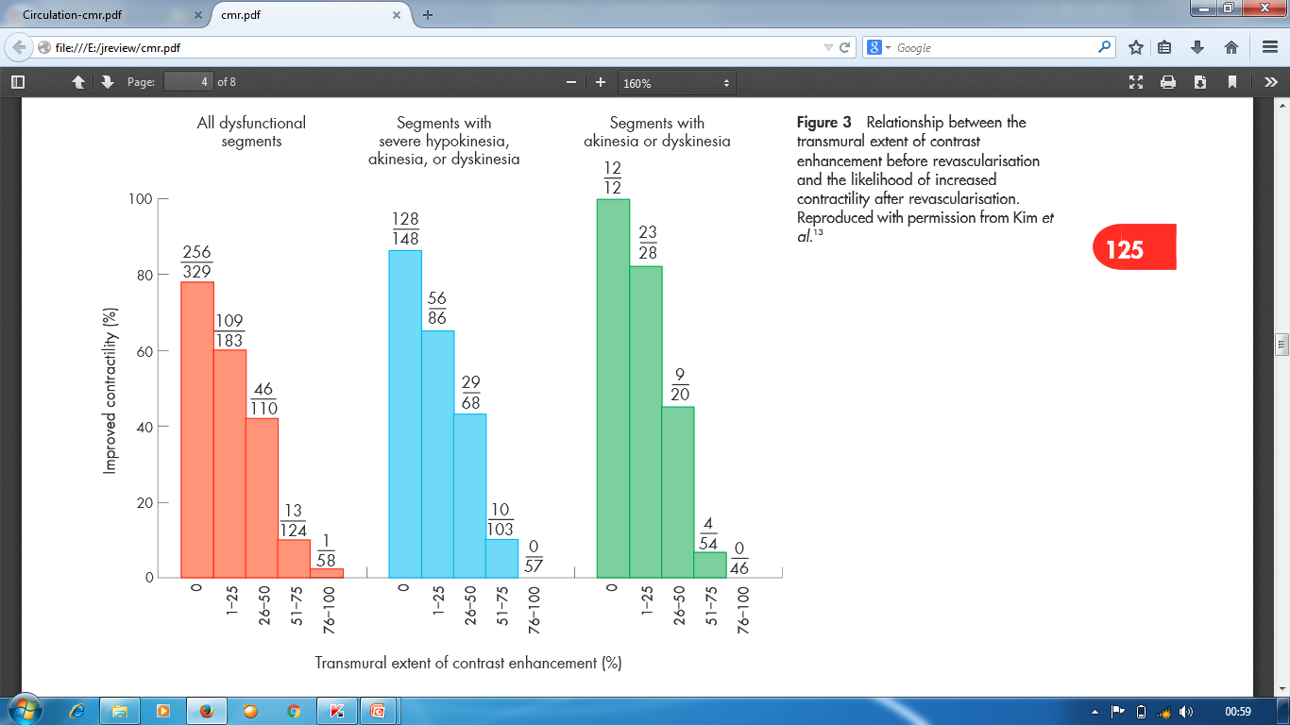
To predict functional recovery in patients with chronic ischaemia
Kim RJ et al.N Engl J Med 2000;343:1445–53.The first study to demonstrate that ceCMR can accurately predict reversible myocardial dysfunction in patients with ischaemic heart disease before coronary revascularisation.

Slide 27
MSCT
Iodinated contrast agents accumulate in infarcted myocardium similar to MRI
High spatial resolution-differentiation of transmural & subendocardial infarction possible
Old infarctions have lower CT densities compared to recent infarcts
Good agreement b/w DEMRI and late enhancement of MSCT

Slide 28
Sensitivity and specificity -92%& 100% respectively to detect viability in acute myocardial infarction
Presence of viable segments in an AMI identified when hyperenhancement is absent or involves <50% of the myocardial wall thickness
Advantages
  Shorter imaging time
  widely available

Slide 29
Comparison b/w different investigations

Slide 30
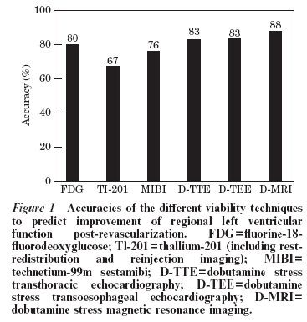
Baer FM, European heart journal 2000

Slide 31
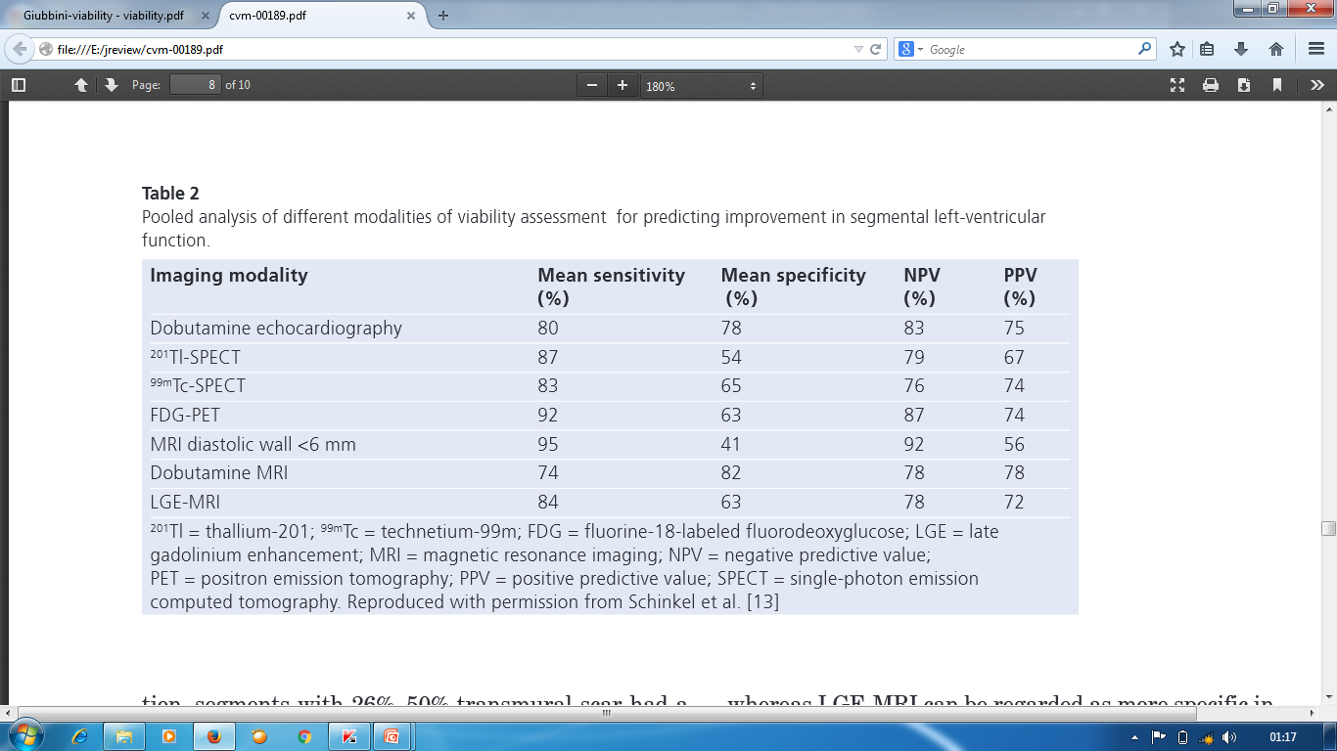
Sensitivity more for PET and SPECTE and specificity more for DSE
Schinkel AF et al. Hibernating myocardium: diagnosis and patient outcomesCurr Probl Cardiol. 2007;32(7):375

Slide 32
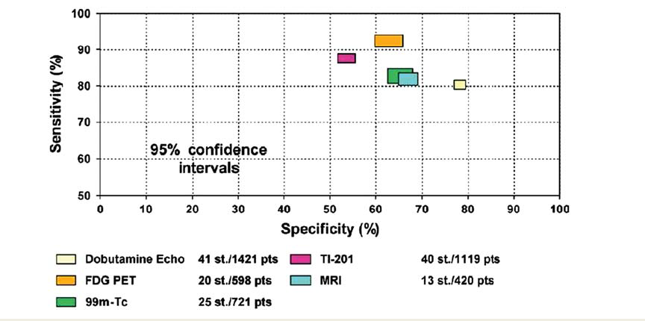
Comparison
European Heart Journal (2010) 31, 2984–2995

Slide 33
Recovery variables

Slide 34
Recovery variables(time course after procedure and extent of viability)
The time course of recovery of viable myocardium can protract up to 14 months
Vanoverschelde J-LJ et al. Am J Cardiol 2000;85:1 1432-1439.
Majority of studies agree that to yield the best sensitivity and specificity to predict > 5% improvement in LVEF, at least 25% of the LV should be viable using DSE and 38% using conventional nuclear medicine and PET.
Bax JJ et al.J Nucl Med.2002;43:795–802

Slide 35
Impact of the time of revascularization
A comparison of the outcome after early (within 30 days) or late (30 days) revascularization in 2 parallel groups of patients showed a significant improvement in function and lower mortality in the group with shorter waiting times.
Bax JJ et al.Circulation.2003;108(suppl):II-39–II-42.

Slide 36
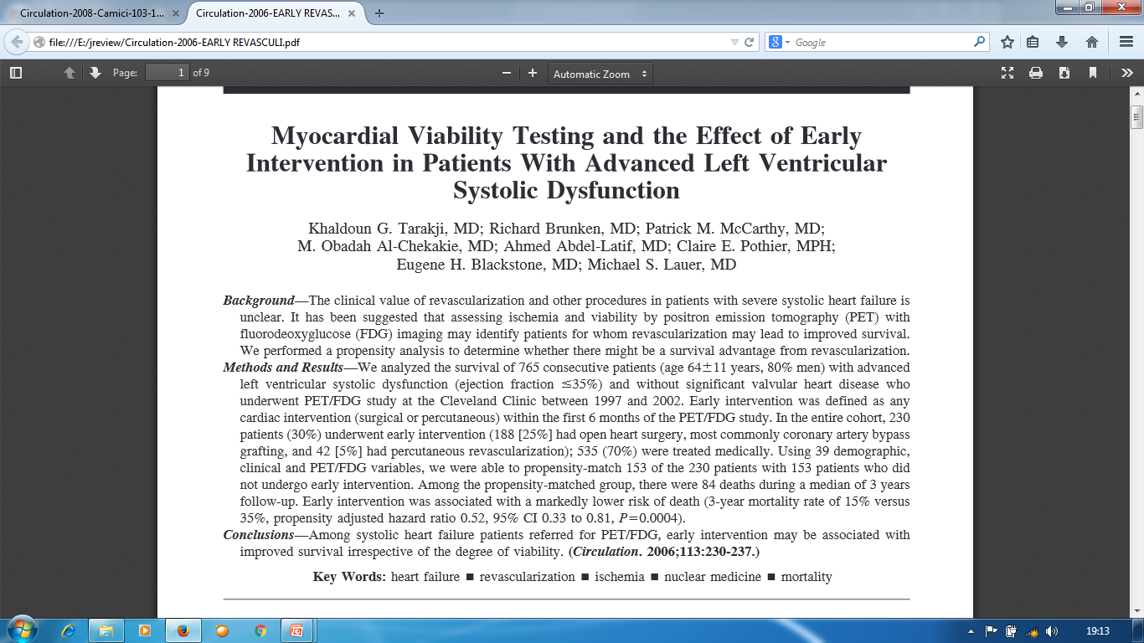
Impact of the time of revascularization

Slide 37
Benefits of Viability Assessment
(META ANALYSIS AND STUDIES)

Slide 38
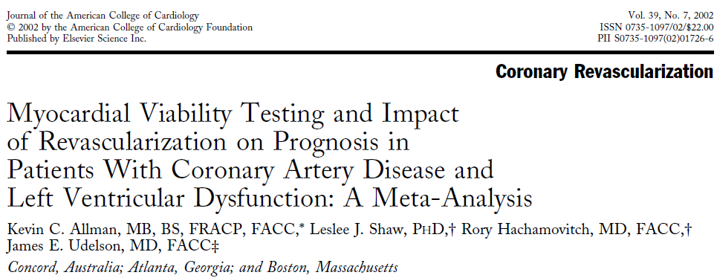
Meta-analysis
J Am Coll Cardiol 2002;39:1151– 8
Late survival with revasc. vs. medical therapy after myocardial viability testing in pts with severe CAD & LV dysfunction
24 studies Thallium, PET & DSE
N= 3,088 (2,228 men), EF 32+8%, followed for 25+10 months

Slide 39
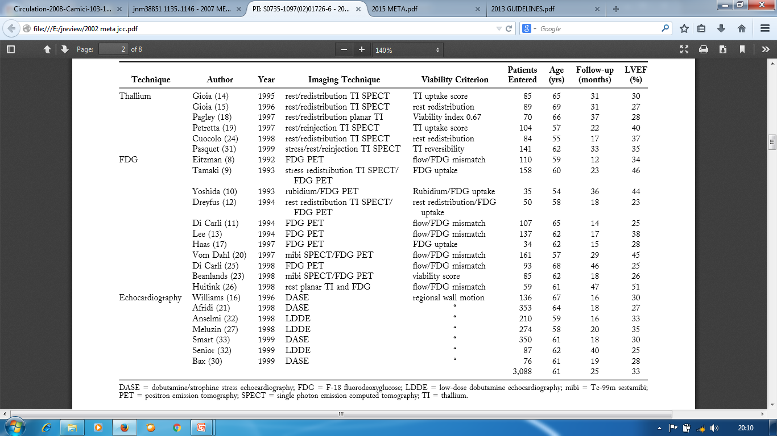

Slide 40
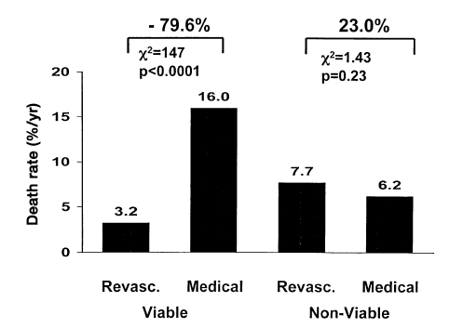
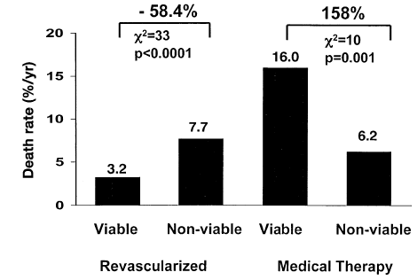
Meta-analysis

Slide 41
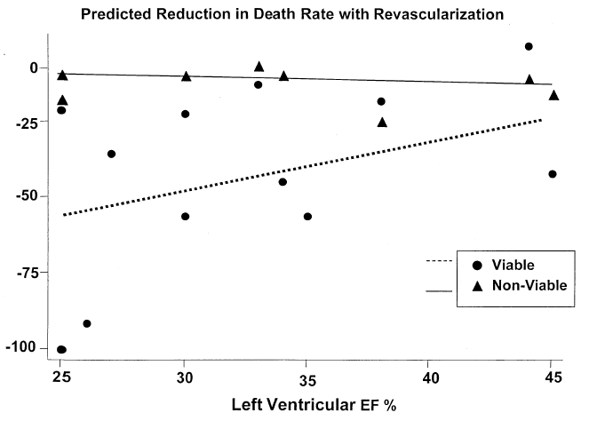
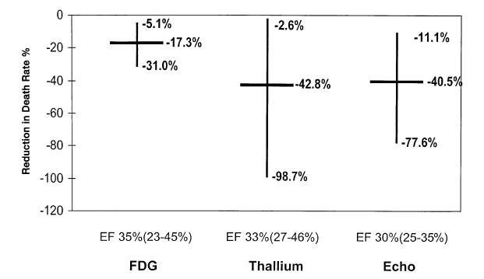
Meta-analysis

Slide 42
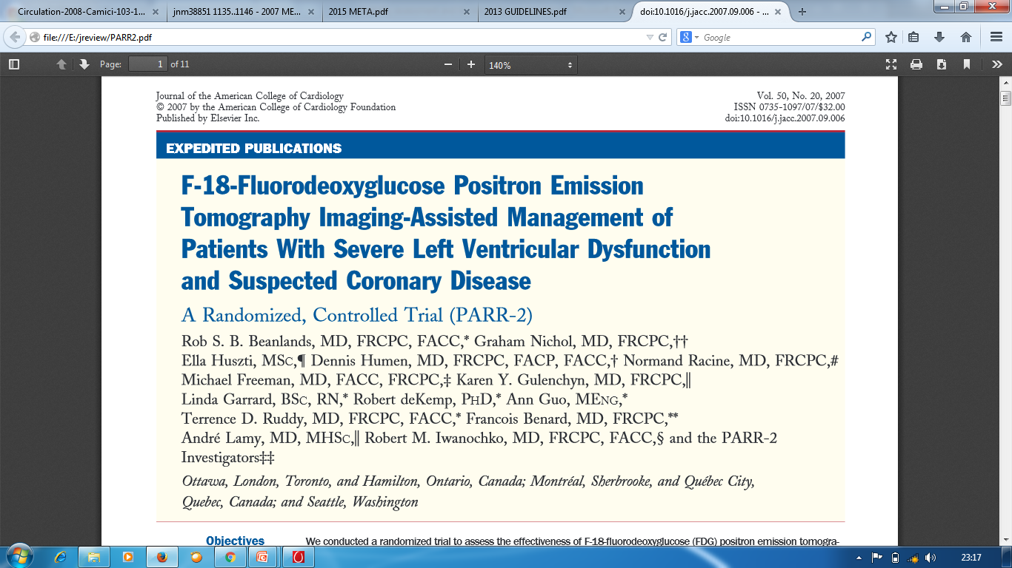

Slide 43
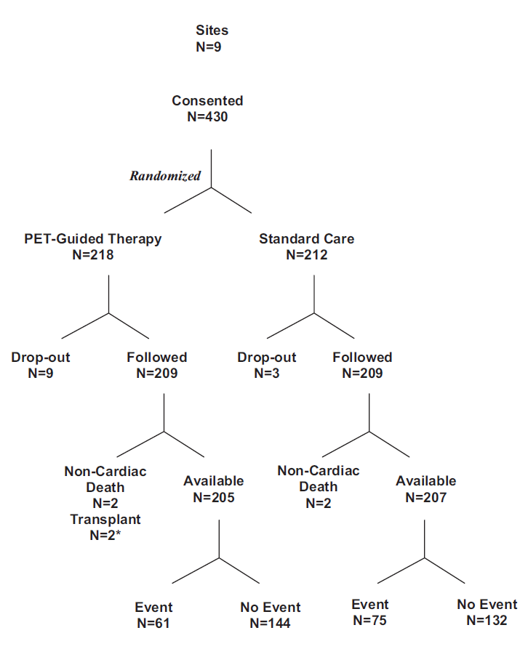
PARR2
[N=430]; EF ≤ 35% considered for revascularization, transplant, or HF work‐ up with high suspicion of CAD.
• Randomized patients to a PET‐guided therapy or “standard care” (no PET).
• Imaging physicians issued a therapy recommendation based on PET findings and treating physicians then made a decision regarding revascularization.
• Patients in the standard care arm had no PET, but could have another viability test, which was performed in 138 of 209 (66%) patients.
• Primary outcome: composite of cardiac death, myocardial infarction or recurrent cardiac hospitalization within 1 year.

Slide 44
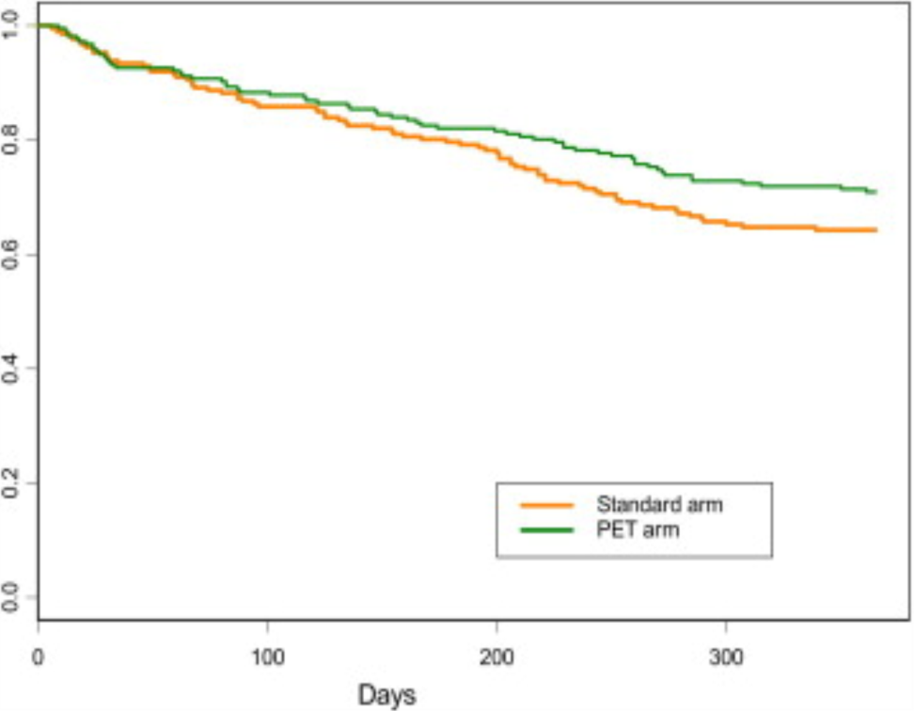
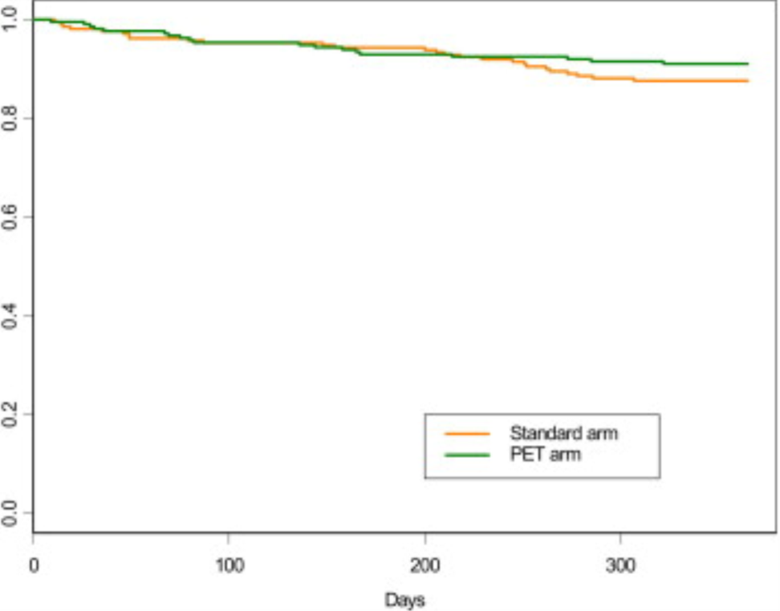
“Survival Curves” (on the Basis of Time to First Outcome of the Composite Event)
hazard ratio = 0.78, 95% CI 0.58 to 1.1, p = 0.15
“Survival” Curves (on the Basis of Time to Cardiac Death) hazard ratio = 0.72, 95% CI 0.4 to 1.3, p = 0.25

Slide 45
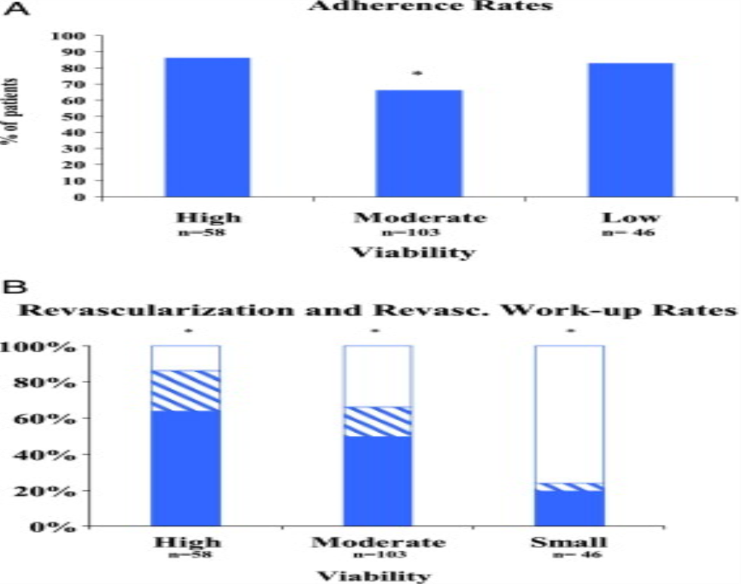
Rates of adherence to positron emission tomography recommendations for revascularization or revascularization work-up
Rates of revascularization (solid bars); revascularization work-up without revascularization (hatched bars), and no revascularization (open bars). Rates of revascularization + revascularization were different between groups

Slide 46
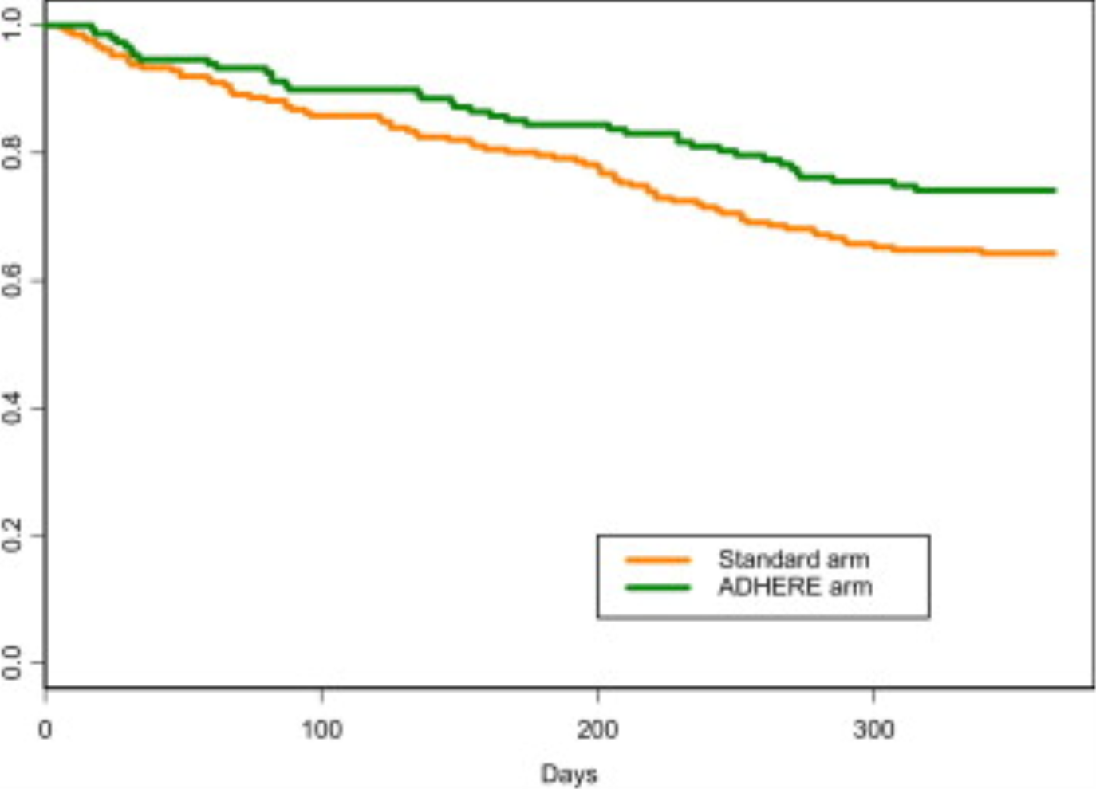
Survival Curve (on the Basis of Time to First Occurring Outcome Out of the Composite Event)
The positron emission tomography adherence group versus standard care arm. adjusted hazard ratio = 0.62, 95% CI 0.42 to 0.93, p = 0.019

Slide 47
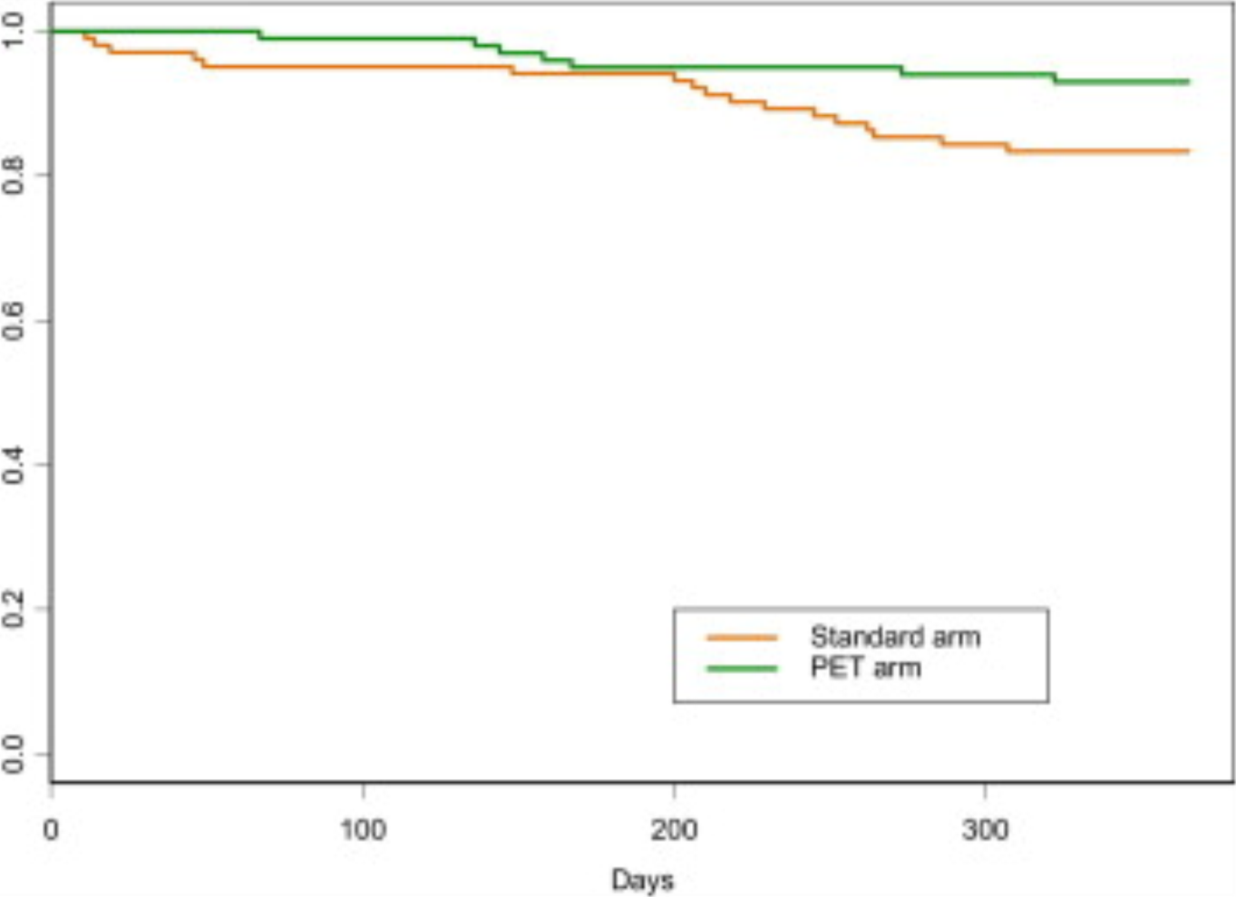
“Survival Curves” (on the Basis of Time to Cardiac Death) for Patients Without Recent Angiography
hazard ratio = 0.4, 95% CI 0.17 to 0.96, p = 0.035

Slide 48
There was no statistically significant difference for the primary outcome measure. However, there are number of important findings from the PARR-2 study
large proportion (approximately 25%) of patients did not adhere to PET recommendations. This implies that, for clinicians to make decisions, evidence for revascularization benefit is not convincing enough.
significant benefit for FDG PET when adhered to the PET recommendations
outcome benefit observed when it was used in addition to a preceding test
patient without recent angiography, who represent sickest group when FDG PET-assisted management used, yields a significant mortality benefit

Slide 49
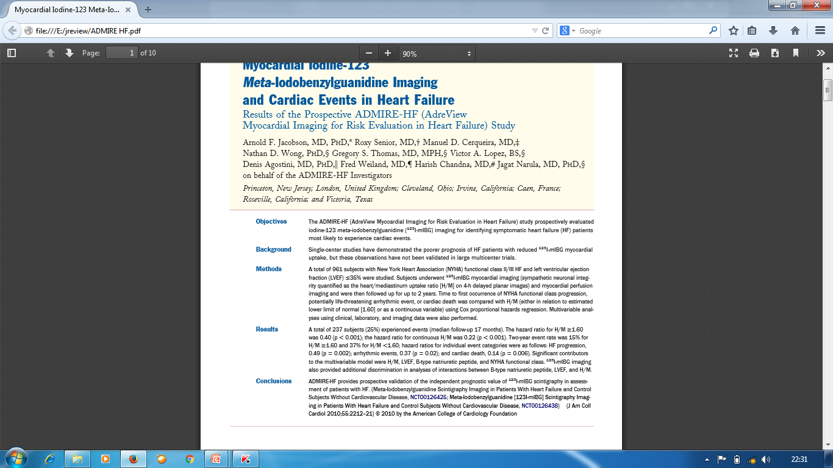
ADMIRE- HF
Notes:
JACC 2010

Slide 50
Increased myocardial sympathetic activity is a prominent feature of heart failure and associated with progressive myocardial remodeling.
Increased neuronal release of norepinephrine is usually accompanied by decreased neuronal NE reuptake due to downregulation of cardiac NE transporter
Decrease in NE reuptake mechanism successfully assessed by radionuclide imaging with iodine-123–labeled NE analog meta-iodobenzylguanidine (123 I-mIBG) using SPECT

Slide 51
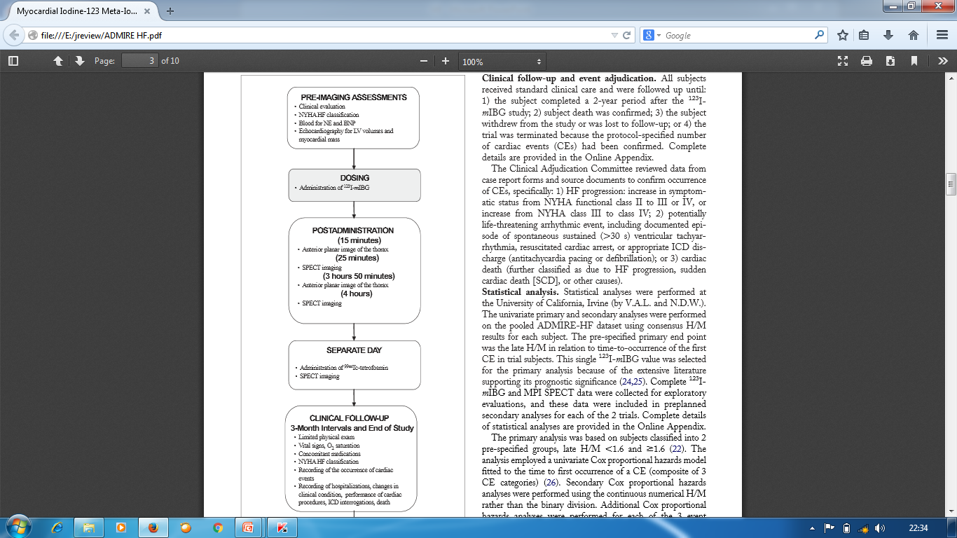
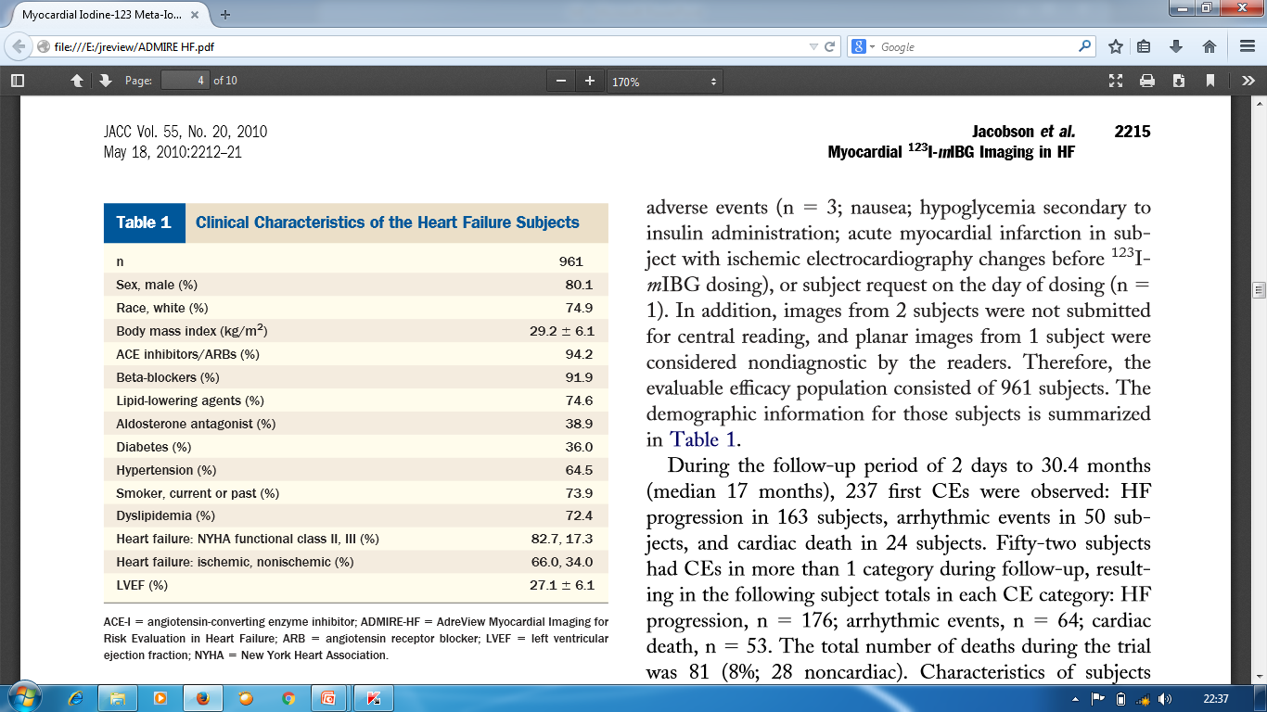

Slide 52
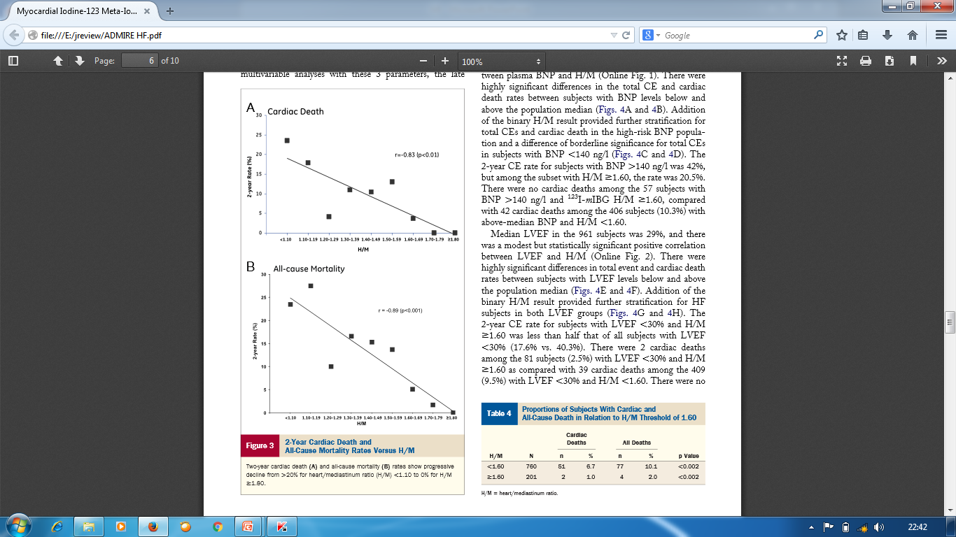
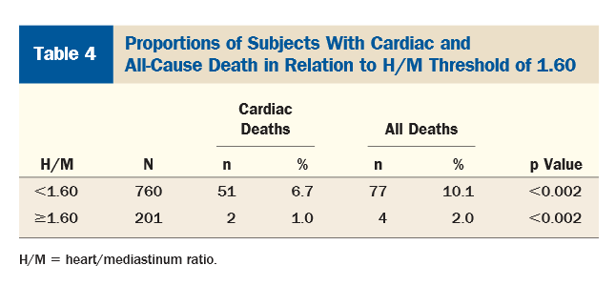

Slide 53
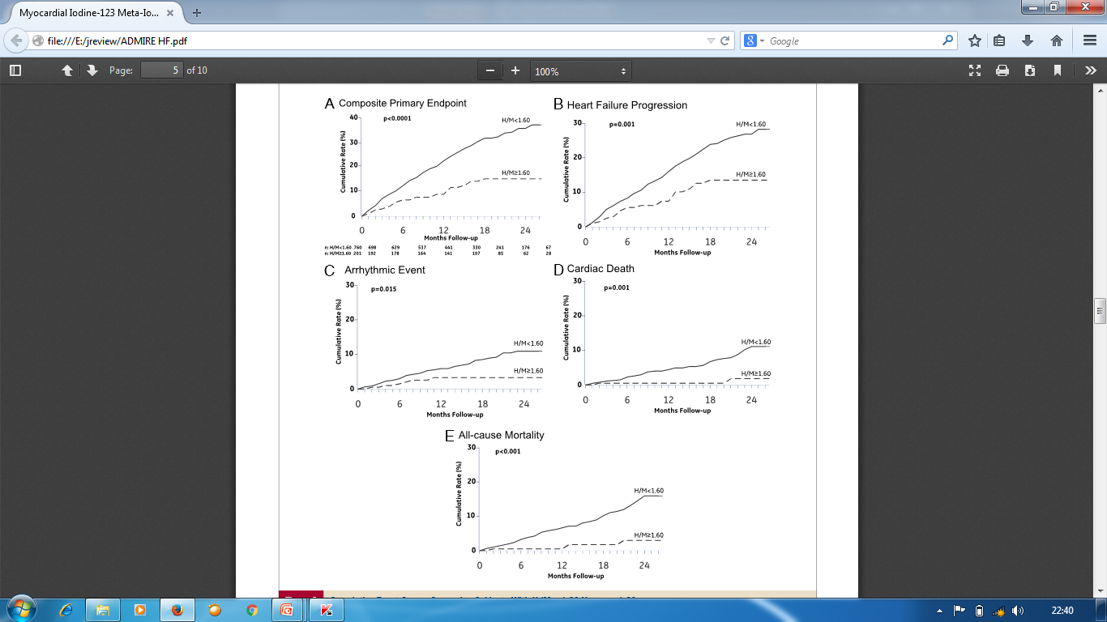

Slide 54
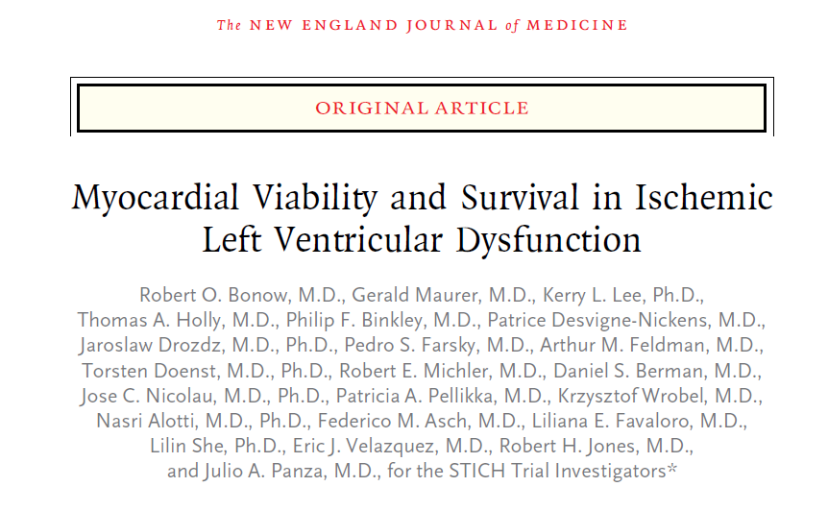
N Engl J Med 2011;364:1617-25
The first prospective randomized trial testing the hypothesis that CABG improves survival in patients with ischemic LV dysfunction [EF-26.7%±8.6] compared to outcome with aggressive medical therapy
Myocardial viability identifies patients with CAD and LV dysfunction who have the greatest survival benefit with CABG compared to aggressive medical therapy

Slide 55
STICH Trial- substudy
All pts eligible for viability testing with SPECT [Tl or Tc] or DSE
  Viability testing optional
  Criteria for myocardial viability were prospective and pre- specified [SPECT (11/17); DSE (5/16)]
Primary endpoint:
  All cause mortality
Secondary endpoints:
  Mortality plus cardiovascular hospitalization
  Cardiovascular mortality

Slide 56
1212
Patients with viability test
Patients with no viability test
618
594
Unusable test
17
Pateints with no usable viability test
611
Patients with usable viability test
601
321
150
130
Viable
Non-Viable
SPECT 471
DSE
471
487
114
243
244
60
54
MED
49.9%
CABG 50.1%
MED
52.6%
CABG 47.4%

Slide 57
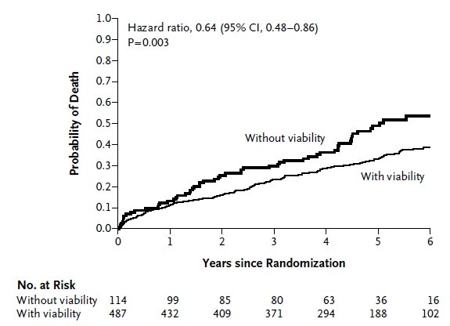
STICH Trial- substudy
After multivariate analysis p=0.21

Slide 58
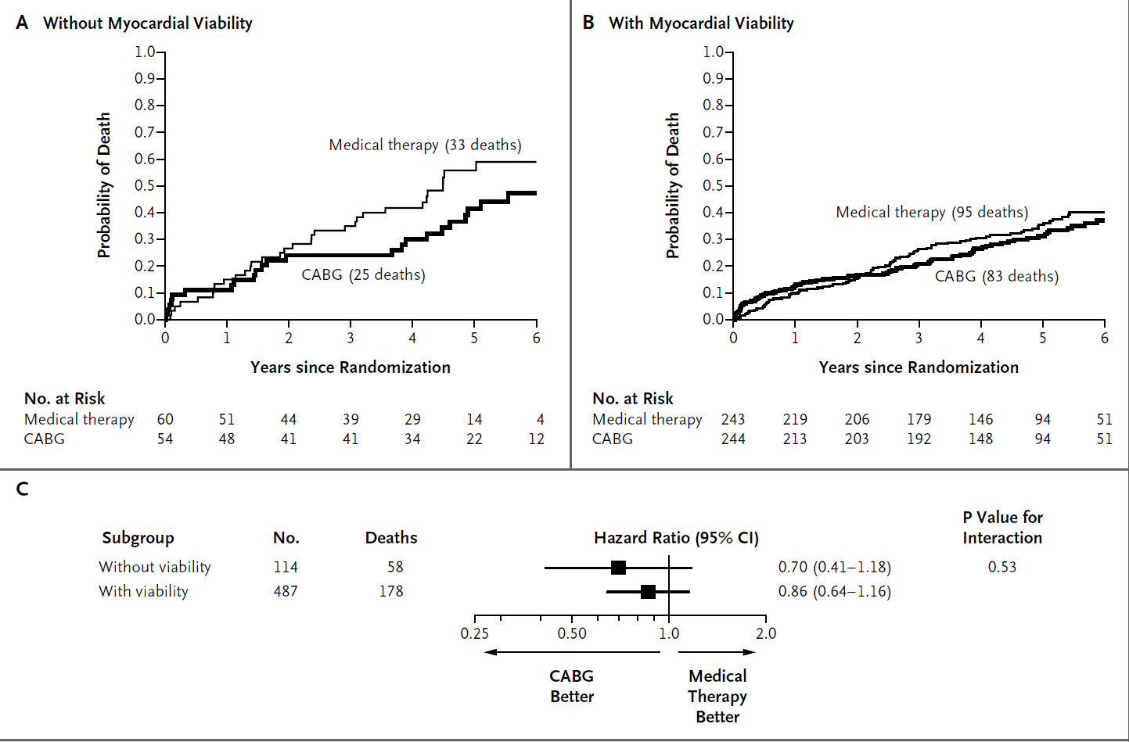
STICH Trial- substudy

Slide 59
STICH Trial- substudy
Substudy of a major trial
Viability study according to the judgement of physician
Small number of non viable group for comparison
Sx influenced by timing and results of viability test
Two types of viability tests-SPECT & DSE
Better medical therapy available
In patients with CAD and LV dysfunction, assessment of myocardial viability does not identify patients who will have the greatest survival benefit from adding CABG to aggressive medical therapy

Slide 60
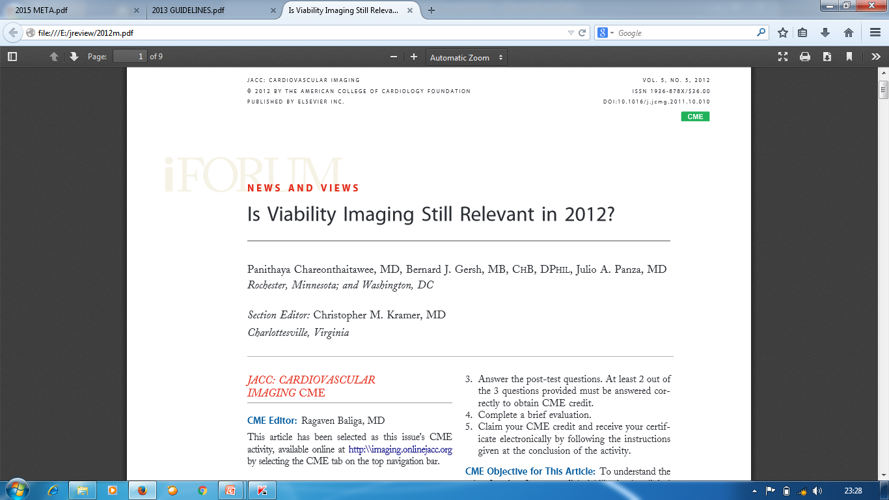

Slide 61
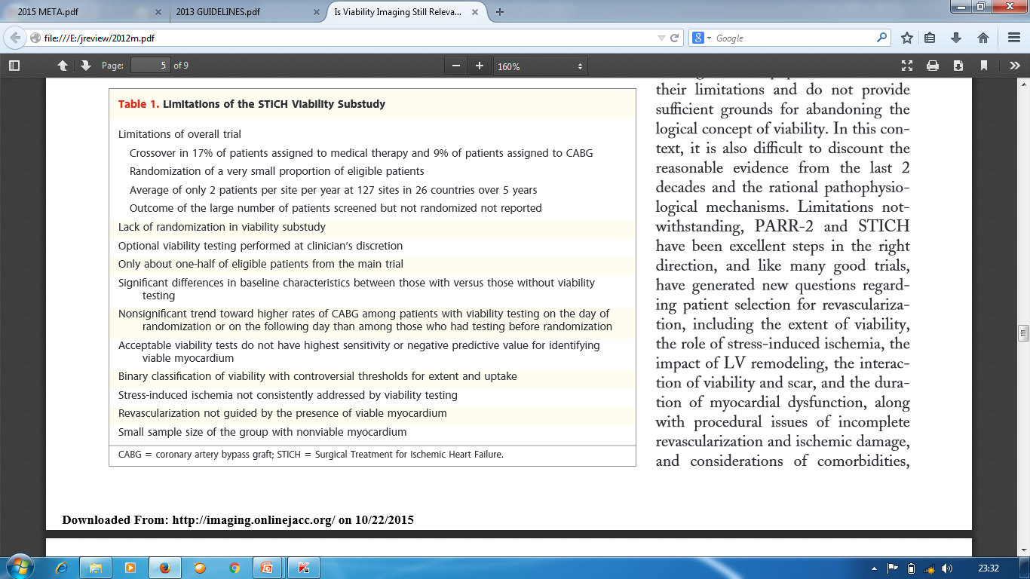

Slide 62
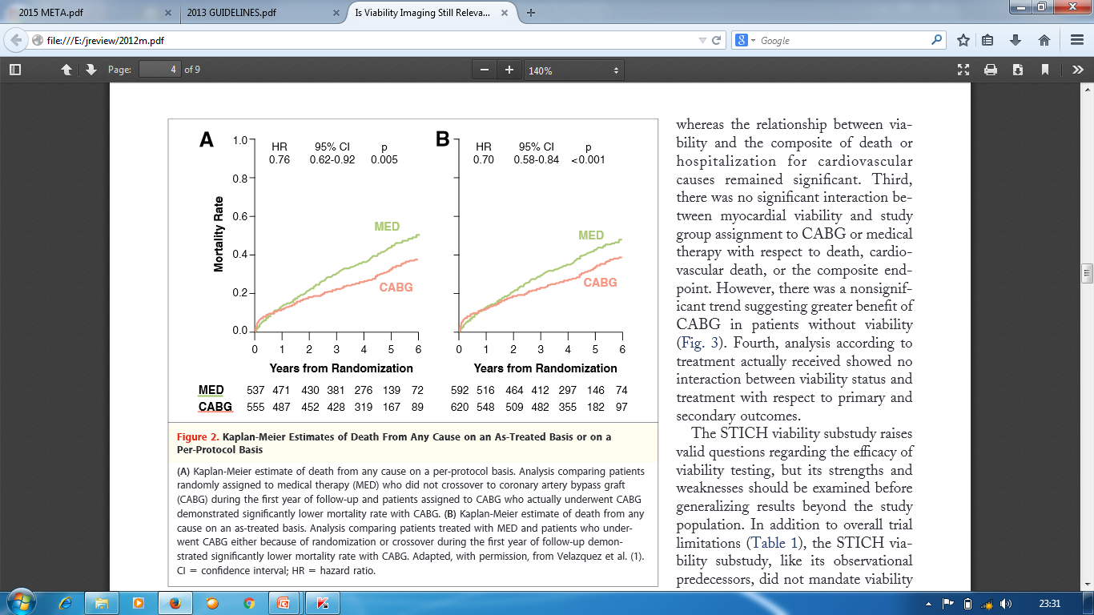

Slide 63
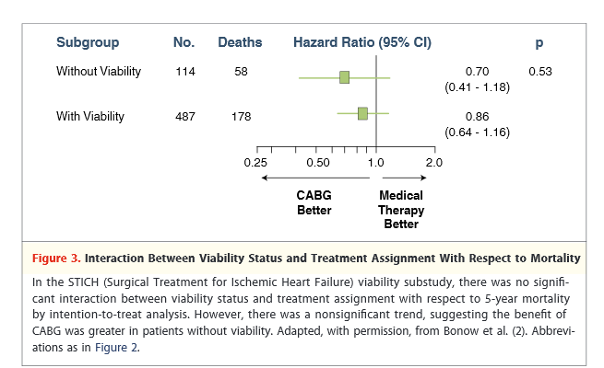

Slide 64
THANK YOU

Slide 65
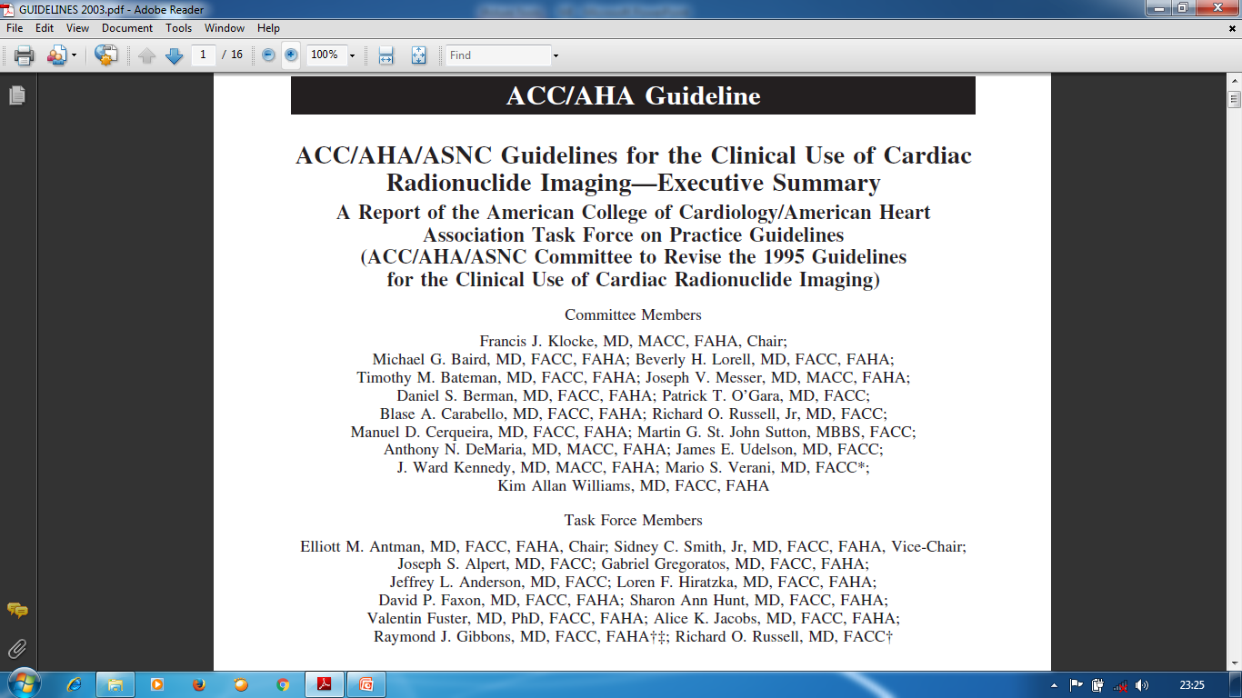

Slide 66
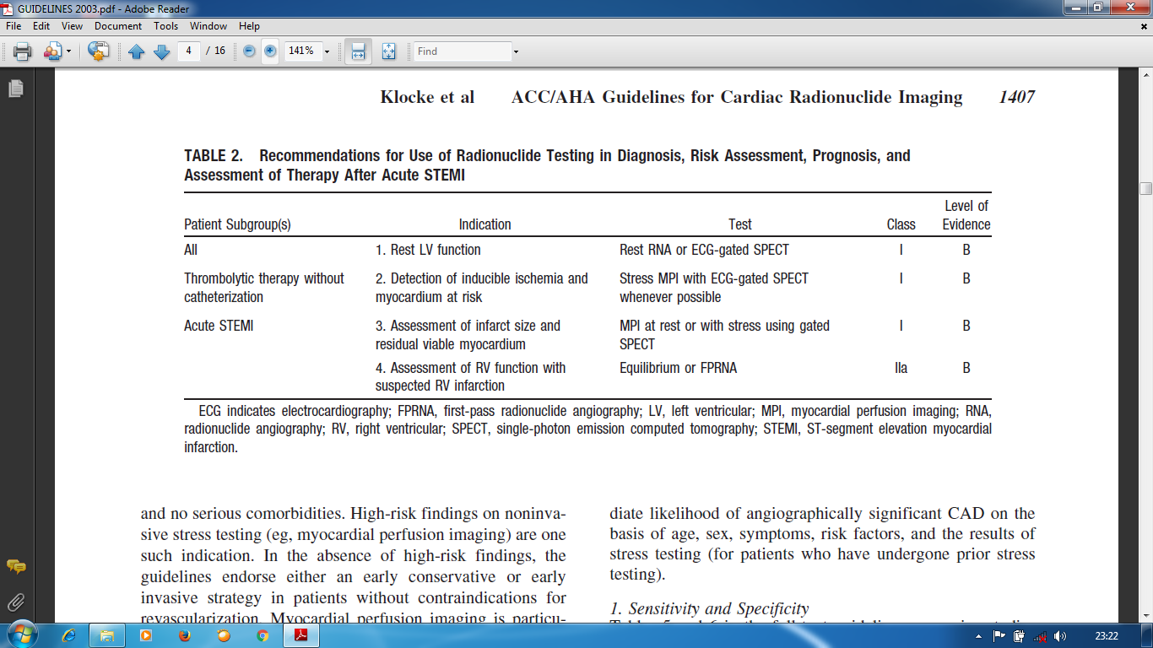

Slide 67
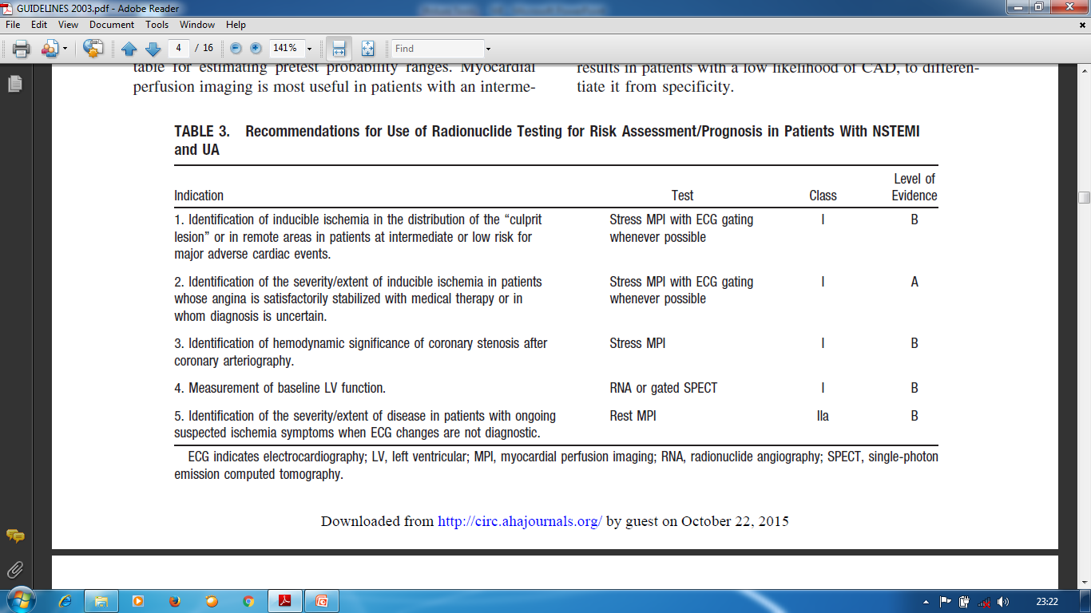

Slide 68
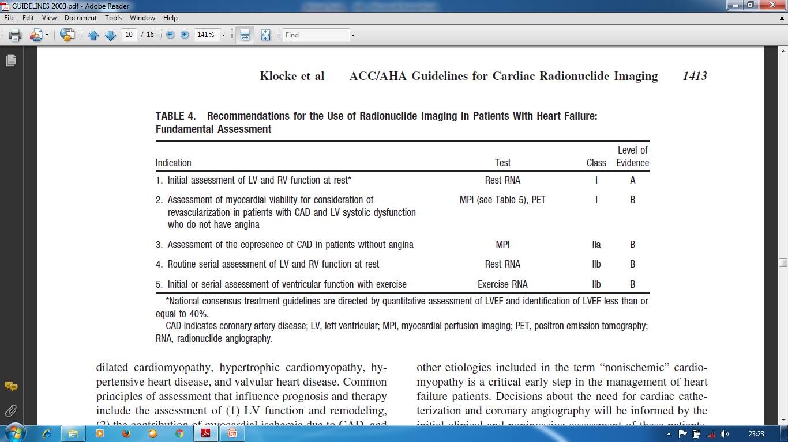

Slide 69
